Slide 1
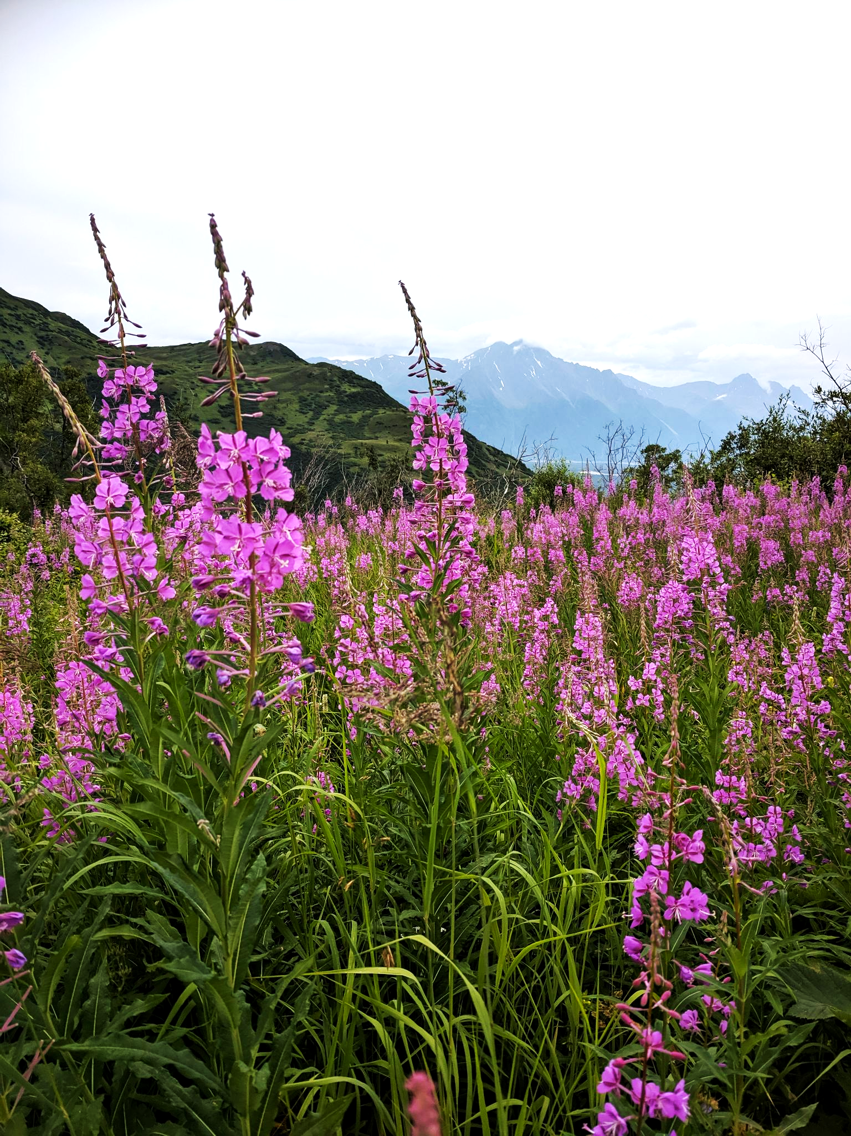

Community Engagement 101
Alli Harvey
Senior Consultant
Presented to the Moolin Seminar
November 16, 2021

Slide 2
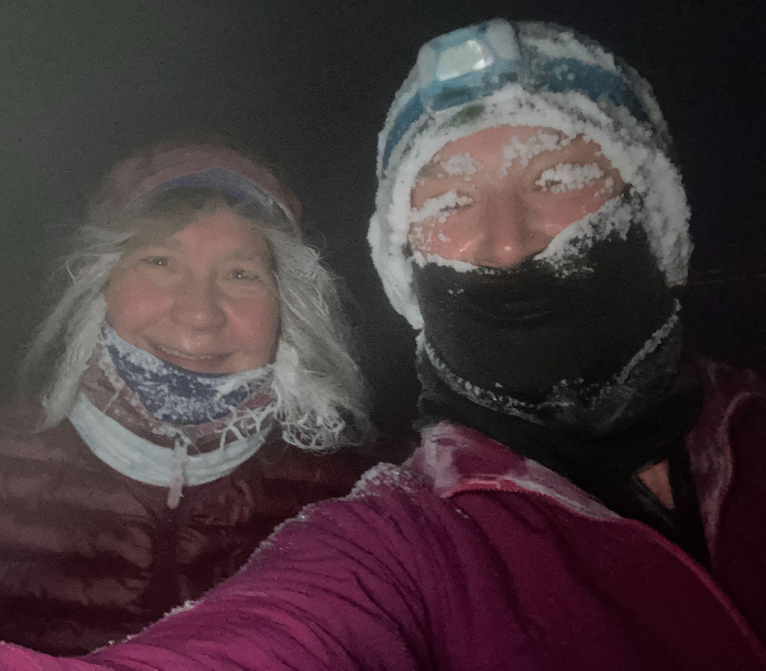
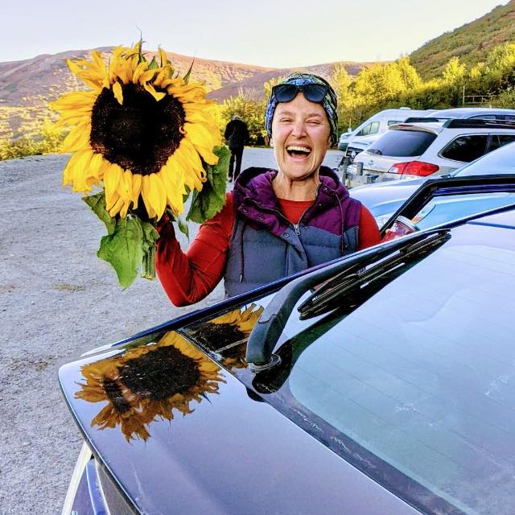

MY STORY
Why community engagement matters to me personally

Slide 3
Today’s
Session
Outline
Part 1: What is community engagement?
Zooming out & back to basics. What are some examples, and lessons learned?
Definition overview
Approach and methodology
Stories and lessons learned
Part 2: Scenarios
How would you approach it?

Slide 4

PART 1: WHAT IS COMMUNITY ENGAGEMENT?

Slide 5
One Definition...
Community Engagement is…the process of working collaboratively with and through groups of people affiliated by geographic proximity, special interest, or similar situations to address issues affecting the well-being of those people It is a powerful vehicle for bringing about environmental and behavioral changes that will improve the health of the community and its members It often involves partnerships and coalitions that help mobilize resources and influence systems, change relationships among partners, and serve as catalysts for changing policies, programs, and practices (CDC, 1997).
'Community engagement' is therefore a strategic process with the specific purpose of working with identified groups of people, whether they are connected by geographic location, special interest, or affiliation to identify and address issues affecting their well-being.

Slide 6
Another Definition...
Community engagement takes a strategic approach to the relationships, communication and interactions between community members and an organization to try to influence outcomes for both.
The United Nations Brisbane Declaration on Community Engagement (International Conference on Engaging Communities, 2005) describes community engagement as a two-way process by which:
the aspirations, concerns, needs and values of citizens and communities are incorporated at all levels and in all sectors in policy development, planning, decision-making, service delivery and assessment; and
governments and other business and civil society organizations involve citizens, clients, communities and other stakeholders in these processes.

Slide 7
CROSS SECTOR - EXAMPLES
Museum Expansion
Resource Development
Food Systems
Others?
A local museum is raising funds for an expansion; an essential part of the process is working with community members to solicit their input and build public goodwill for a likely bonding process
A governmental agency is visiting communities to solicit feedback and comments on new proposed offshore drilling projects
Local civic leaders are working to develop solutions to address food insecurity, and are holding community meetings to determine options

Slide 8
How does community engagement work?
There is no one-size fits all. Highly contextual and adaptive. Key is listening & clear communication.
  Define goal
  Define audience(s)
  Define appropriate venue(s)
  Define method of outreach appropriate for audience(s)
  Consider who is easily reached; who is not and fine tune outreach (consult with community leadership as appropriate)
  Clarify boundaries
  Clarify how decisions are made
  Clarify how information will be used

Slide 9
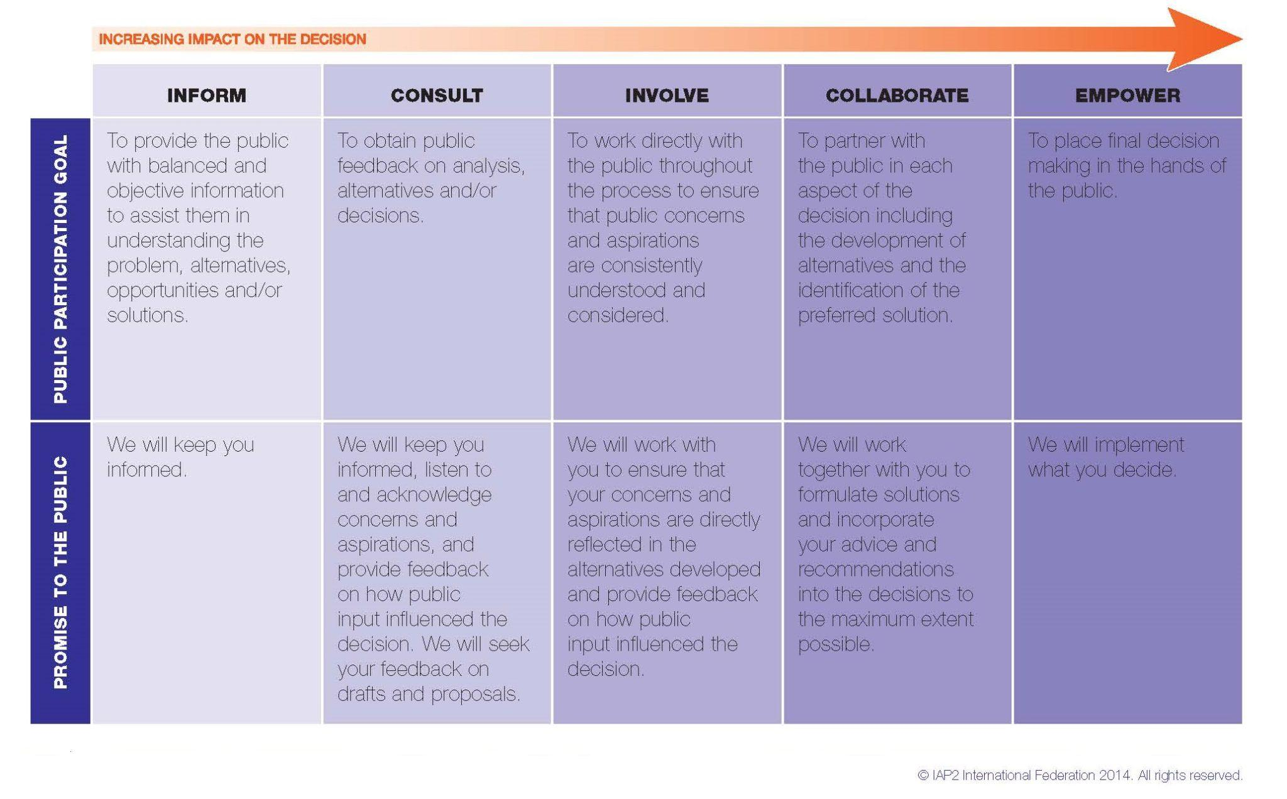
One model of decision making

Slide 10
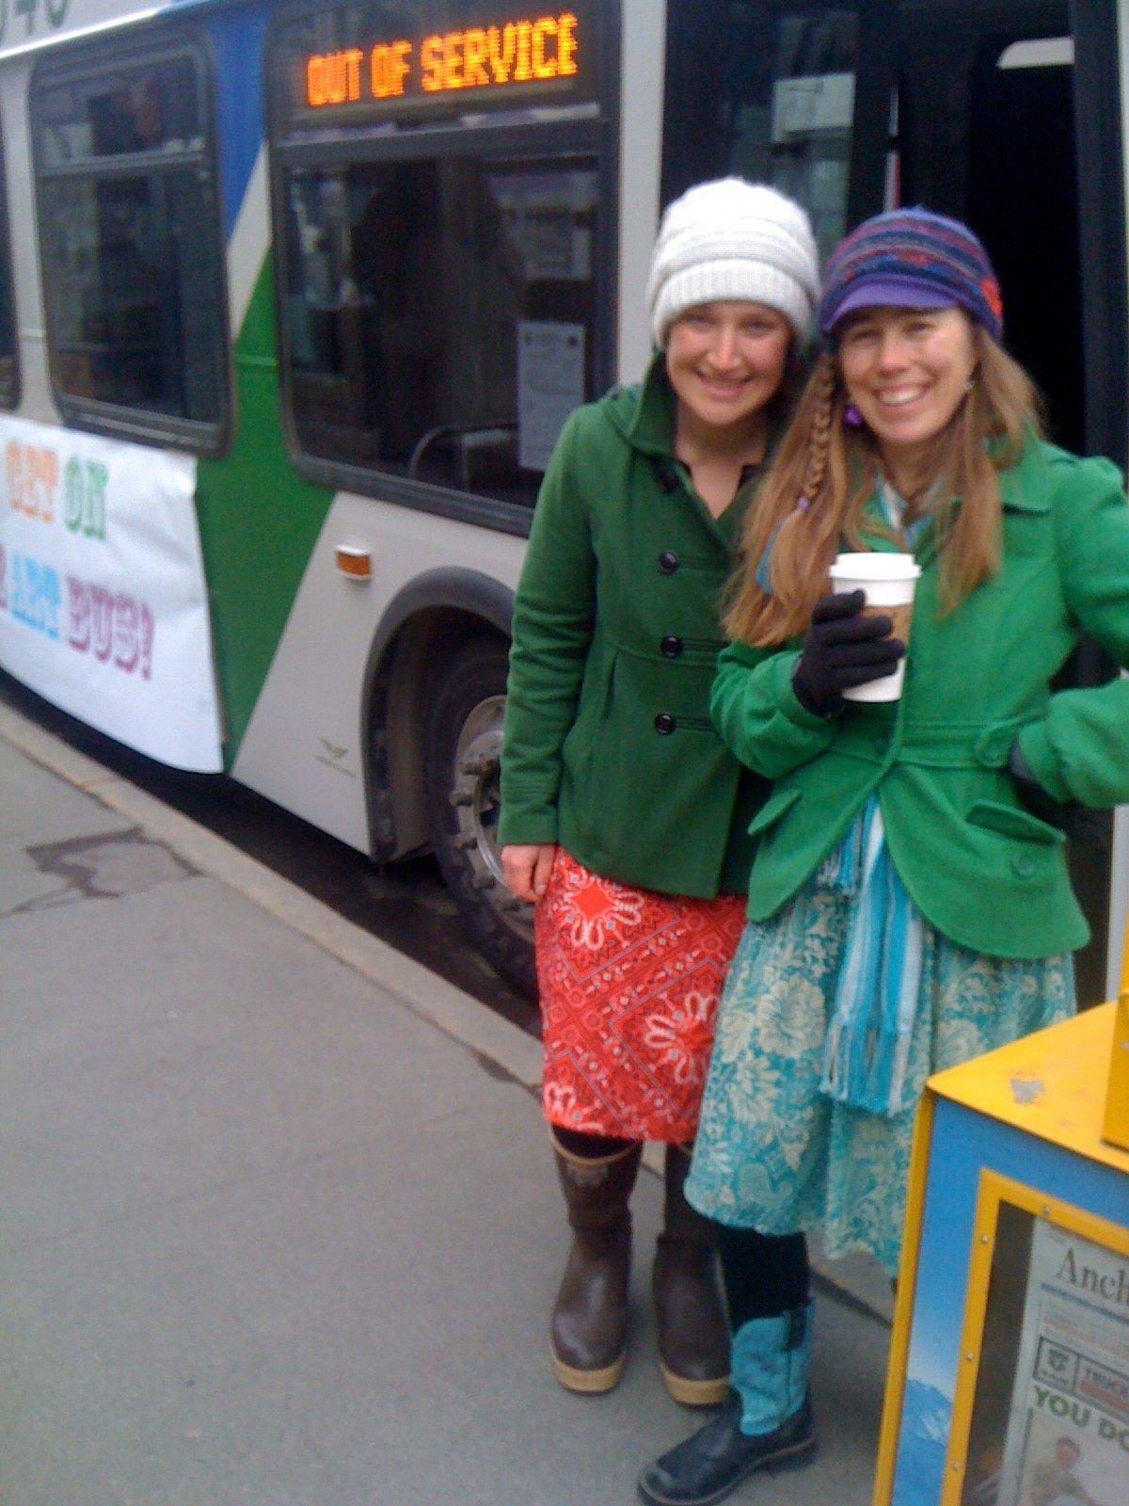
Story #1
People Mover turned Art Gallery to boost ridership and pass transit-related municipal bond
Lessons learned:
Creative engagement is a +
Experiential opportunities are exciting
Incentives are good
Build momentum, where possible

Slide 11
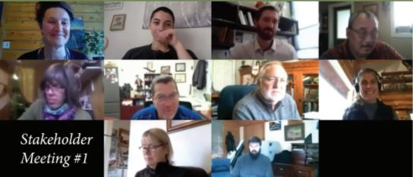
Story #2
Creating a Historic Preservation Plan for the Mat-Su Borough
Lessons Learned
People looking for connection and meaning, especially during the pandemic
Don’t schedule a public meeting on the day before a presidential election
Remote tools are powerful
Facilitation is key

Slide 12
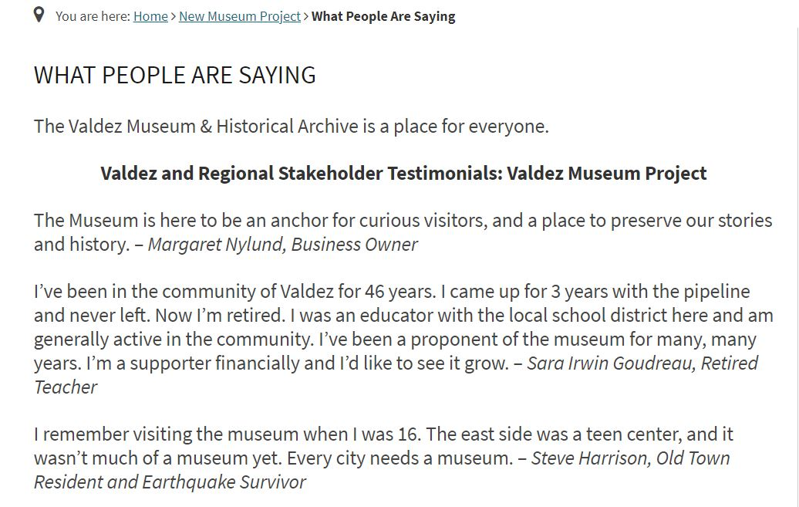
Story #3
Engaging the public on planning & fundraising for a museum expansion
Lessons Learned
Transparency on what is/isn’t on the table
Listening
Facebook power and peril

Slide 13
DISCUSSION

Slide 14
SESSION BREAK

Slide 15
PART 2: SCENARIOS

Slide 16
Breakout Room Assignment
Purpose of Session: Discussion, not decisions
1.) What is your goal for community engagement with this project? What is on the table for input/what, if anything, is not?
2.) What communities/stakeholders might be impacted by the project? These might already be listed, depending on your scenario. Review and discuss if any stakeholders might be missing from the list.
3.) What information would you gather about these communities prior to engaging, and how?
4.) What methods would you use to engage the community(s) you’ve identified? Why those methods?
5.) How might you approach concerns, or outright opposition?
5.) How do you follow up?
Take a photo of this slide

Slide 17
WELCOME BACK!
New insight or aha’s
Any next steps or actions

Slide 18
THANK YOU!

